Slide 1
Family Systems Therapy
Althea Fernandes
Marvin VandenHoek

Slide 2
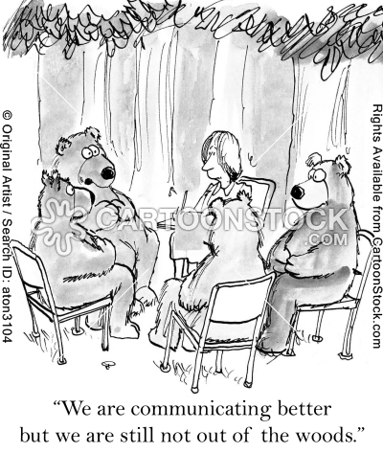
TABLE OF CONTENTS
History and Theoretical Frameworks
Founders and Key Influences
Techniques
Myths of Family Therapy
Strengths and Limitations
Discussion Forum Questions
Resources and References
http://www.cartoonstock.com/cartoonview.asp?catref=rhan1350

Slide 3
HISTORY AND THEORETICAL FRAMEWORKS
What is it?
Branch of psychotherapy that works with familial systems to nurture change and development.
Why is there a need?¹
We are all born into families even though we are autonomous individuals. This is a lifelong attachment for most of us.
Understanding individuals through assessing their interactions with their family members is beneficial
The client’s problem may not be a symptom of what is going on just for the client, but it may be a symptom of how the family system functions.
Families determine:
Who we are
How we develop
How we give and receive support for survival
¹ Corey, 2009

Slide 4
HISTORY AND THEORETICAL FRAMEWORKS
What is the source of problem?
Problematic behaviour has function in the family and is often unintentionally supported by family processes
This behaviour develops from the inability of a family to operate productively
It could be a symptom of trans-generational dysfunctional patterns
How does change occur?
Working with the entire family/relationship and not just the individual
Change can occurs through cognitive, behavioural and even emotional means

Slide 5
HISTORY AND THEORETICAL FRAMEWORKS
Who does it focus on?
In general, family can be defined according to the individuals closest emotional connections
*Note: Becvar and Becvar (as cited in Corey, 2009) maintain that relationship therapy is a more proper term than family therapy, since many of the principles apply to relationships in general.
Individual versus systemic approaches¹
Individual | Family Systems
Focus on Diagnosis | Explore family dynamics
Begin therapy immediately | Invite family members into therapy
Focus on causes and purposes, as well as cognitive, emotional, and behavioural processes | Focus on family relationships
Be concerned with individual experiences and perspectives | Be concerned with trans-generational and other cultural and community perspectives.
Interventions are based on coping | Interventions are based on context
¹ Corey, 2009

Slide 6
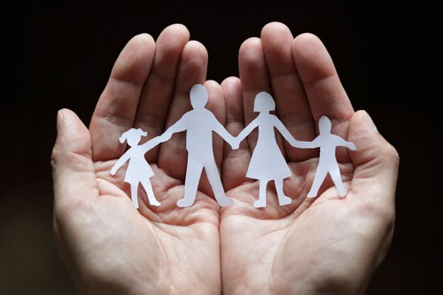
FOUNDERS AND KEY INFLUENCES
“I describe family values as responsibility towards others, increase of tolerance, compromise, support, flexibility. And essentially the things I call the silent song of life—the continuous process of mutual accommodation without which life is impossible.”
~ Salvador Minuchin
U.S Family Therapist. As quoted in “On Family Therapy: A Visit with Salvador Minuchin”, Psychology Today (March-April 1993)
“It is clear to me that the family is a microcosm of the world. To understand the world, we can study the family: issues such as power, intimacy, autonomy, trust, and communication skills are vital parts underlying how we live in the world. To change the world is to change the family.'‘
~ Virginia Satir
U.S Family Therapist and author. The New Peoplemaking, Ch.1 (1988).

Slide 7
Timeline of the development of family systems therapy
Experiential Family Therapy – Carl Whitaker
Stressed choice, freedom, self determination, growth, and actualization.
Stated that is was the personal involvement of the therapist with the family that made a difference.
Alfred Adler
Emphasis on birth order
Families often become locked in repetitive, negative interactions.
Multigenerational – Murray Brown
Worked with families affected be schizophrenia
Key concepts
Triangulation
Differentiation of self
Structural-strategic family therapy – Salvador Minuchin & Jay Haley
Seek to reorganize dysfunctional or problematic structures in families
Rudolf Dreikers
Refined Adler’s concepts and created an organized approach.
Recent Innovations
Clients are treated as the experts in their own lives.
The therapist is active in aiding clients to take a stand against what oppresses them.
Human validation process model – Virginia Satir
Emphasized the importance of communication and meta communication in families.
Valued therapeutic validation in the process of change.

Slide 8
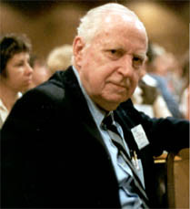
Murray Bowen Multigenerational Therapy
Theorist: Bowen
American; Created one of the first comprehensive theories of family systems functioning that emphasized theory and insight over action and technique
Classic Text: Family Therapy in Clinical Practice (Bowen, 1978)
http://www.youtube.com/watch?v=USzTMpD8YAc
Basic Principles:
Believed family to be an emotional unit where any change in the emotional functioning of one member affects the emotional functioning of other members
Role of Therapist:
The therapist serves as a guide, someone who is an objective researcher.
It’s very difficult to summarize these theories in a sentence or two.
For a more complete description of each of them visit: http://ideastoaction.wordpress.com/dr-bowen/

Slide 9
Murray Bowen Multigenerational Therapy
Core Techniques:
Triangle: The smallest stable relationship system. 2 can’t handle tension, 3 spreads it out.
Differentiation of self: Everyone is influenced by others. The poorer our “self” is developed, the more others impact our functioning and the more we try to impact others.
Nuclear Family Emotional System: 4 basic relationship patterns that govern where problems develop in a family: a) Marital conflict, b) Dysfunction in one spouse, c) Impairment in one or more children, and d) Emotional distance.
Family projection process: The way parents transmit their emotional problems to a child.
Multigenerational transmission process: The way family members relate to each other creates differences that can be transmitted across generations.
Sibling position: People who grow up in the same sibling position usually have important common traits. (E.g. oldest children often have leadership positions and youngest children are often followers. - Built on the work of Walter Toman).
Emotional cut-off: When a family members attempts to deal with unresolved issues by reducing or eliminating contact with them.
Societal emotional process: Each of these concepts applies to other social groups.
Goals of Therapy:
To decrease the levels of anxiety in the family system, and change the individual within the context of the family system
Therapy in Practice: An Example
The therapist might explore with an individual how his/her actions effect or are effected by the others in the family system.

Slide 10
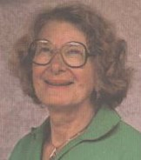
Virginia Satir Human Validation Process Model
Theorist: Satir
American; Widely known as the “Mother of Family Therapy”; Developed conjoint family therapy; She was known for her determined belief that love and nurturance are the most important healing aspects of therapy.
Classic Text: Conjoint Family Therapy (Satir, 1964)
http://www.youtube.com/watch?v=gW3KShRdKMo
Basic Principles:
Emphasis on communication and experiencing/expressing emotions.
Techniques are secondary to the relationship the therapist develops with the family.
Role of Therapist:
The therapist is to act as the nurturing teacher/facilitator.
The therapist shows empathy for those involved.

Slide 11
Virginia Satir Human Validation Process Model
Core Techniques:
Caring and acceptance as key elements in helping people to face their fears and open up their hearts to others.
Some techniques used are: Touch, communication, sculpting, role playing and family life chronology
Goals of Therapy:
To improve relationships and communication within the family unit
Therapy in Practice: An Example
Open discussion with all family members of family rules are often a part of this model. Reasons for rules, validity of rules, how rules lead to greater functioning or dysfunctioning are all discussed in an open way.

Slide 12
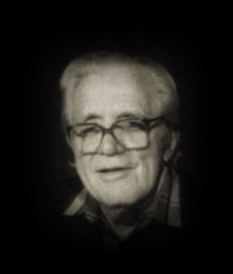
Carl Whitaker Experiential Family Therapy
Theorist: Whitaker
American; Relied on own personality and developed a free-wheeling, intuitive approach; pioneered use of co-therapists to maintain objectivity
Classic Text: The Family Crucible ( Napier & Whitaker,1978)
http://www.youtube.com/watch?v=1O83anXmvv8
Basic Principles:
Active and personal involvement by a caring therapist who puts pressure on the process produces change in family dynamics
Designed to increase clients’ awareness of inner potential and to open channels of family interaction
Role of Therapist:
Active participant and coach
Can be confrontational
To unmask pretenses and create new meanings
Support spontaneity and creativity

Slide 13
Carl Whitaker Experiential Family Therapy
Core Techniques:
No set of methods; technique arises from intuitive and spontaneous reactions to the present situation
Redefinition of symptoms as efforts for growth; Modeling of alternatives; Adding practical interventions; Affective confrontation
Goals of Therapy:
Facilitate individual autonomy while retaining a sense of belonging in the family
Help individuals achieve more intimacy by increasing their awareness
Encourage members to be themselves by freely expressing what they are thinking and feeling
Therapy in Practice: An Example
In order to understand family dynamics, a therapist who practices experiential family therapy would not have a problem being blunt and asking the wife why she chose to marry her disabled husband.

Slide 14
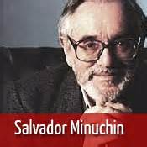
Salvador Munichin Structural Family Therapy
Theorist: Munichin
Argentian; Noticed two patterns common to troubled families: a) “Enmeshed” Systems = chaotic and tightly interconnected and b) “Disengaged” Systems = isolated and seemingly unrelated
Classic Text: Families and Family Therapy (Minuchin, 1974)
http://www.psychotherapy.net/video/minuchin-family-therapy
Basic Principles:
Families are structured in “subsystems” with “boundaries”
Symptoms are a by-product of structural failings
Role of Therapist:
Help the family modify stereotypical patterns and redefine relationships and hierarchies among family members

Slide 15
Salvador Munichin Structural Family Therapy
Core Techniques:
Modify family’s transactional patterns
Develop more appropriate boundaries
Create an effective hierarchical structure
Goals of Therapy:
Structural changes in family relationships can help reduce/eliminate individual symptoms
Therapy in Practice: An Example
Therapists who practice from a structural family therapy perspective when noticing that one parent tends to talk to a child instead of communicating with his/her partner will seek to strengthen the boundaries in order to re-establish a better functioning parental system.
Transactional Patterns: Ways the family regulates itself; The stable structure within each the member live and interact

Slide 16
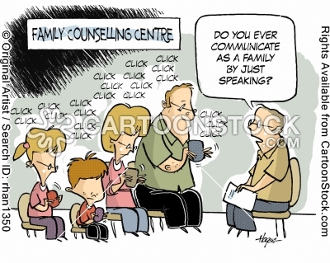
TECHNIQUES
http://www.cartoonstock.com/cartoonview.asp?catref=rhan1350

Slide 17
TECHNIQUES
Forming a Relationship
Begin relationship right at first moment of contact
Some therapists work with any family members who wish to come; Some will only work with all members
Conducting an Assessment
Genograms; Circular questioning; Formal tests/scales
Select a lens for further inquiry
Individual Internal Family System; Teleological/Goal-Oriented, Developmental, Sequences/Patterns of Interactions, Organization, Multicultural, Process and Gender
Hypothesizing and Sharing Meaning
Invokes feedback;
Seeks permission for disclosure: “I have an idea I would like to share with you. Would you be willing to hear it?”
Facilitating Change
Via Enactments
Via Task Assignments

Slide 18
TECHNIQUES
Genograms
Is a pictorial display of a person’s family relationships, usually go through hereditary patterns and psychological factors
Used to identify repetitive patterns of behaviours
Can be used to describe family, emotional and social relationships
Helps family therapists makes appropriate assessments of the relationship patterns and where interventions can be used to help reduce the family dysfunction
http://www.genograms.org/patterns.html

Slide 19
TECHNIQUES
Eight lenses or meta-frameworks from which family systems can be assessed
Individual Internal Family System
Teleological/Goal-Oriented
Developmental
Sequences/Patterns of Interactions
Organization
Multicultural
Process
Gender

Slide 20
TECHNIQUES
Individual Internal Family System Lens
Teleological/Goal-Oriented Lens
Views individual as a system with structure, organization and subsystems
Some dimensions are enhancing while some destructive
Parts are strengthened/developed by social interactions and experiences
When parts become polarized – individual experiences conflict
How does each person describe who he/she is?
Develop an understanding of what motivates individual behaviour, i.e. the purpose of patterned interactions
Individuals and families act purposively – some actions promote growth while some constrain growth
What purpose is being served when the children interact with their parents in the way they do?

Slide 21
TECHNIQUES
Sequences/Patterns of Interaction Lens
Organization Lens
Family life is ordered and family members tend to interact in sequences that are repeated over time
Adaptive sequences develop in cooperative and fair environments while maladaptive sequences develop in rigid ones where change is resisted
What routines support the daily living of each member of the family?
In order to provide a sense of unity, individuals and families are organized by rules, routines and expected roles.
Balanced family leadership requires the ability to be firm but friendly while setting appropriate yet fair expectations
Are the parents effective leaders of the family?

Slide 22
TECHNIQUES
Developmental Lens
Multicultural Lens
Focus is on the “family life cycle” which has 6 significant transitions
Single adult leaves home
Individuals become a couple
Couple has children and starts family
Children become adolescents
Parents prepare for life without children
Children now have to care for parents and their own families
Address needs of individual while considering transitional stage, looking for constraints
Where is the family in the family life cycle, and how are they handling transitions?
Challenges and reframes dominant culture
Looks at:
Ethnicity
Gender
Age
Religion
Race and discrimination
Regional background, etc
What cultures are in the family backgrounds of each of the family members?

Slide 23
TECHNIQUES
Gender Lens
Process Lens
Address power positions that are part of the hierarchical structure of families
Challenge unequal status and treatment of women
What gender role is each member of the family assuming?
Examine where families are in the flow of life and the process of change
When routines are interfered with, the result is disruption to the balanced system which can lead to a state of chaos in the family
Therapists serve as external resource with a primary responsibility to help individuals reconnect with their strengths
Where is this family in the process of change?

Slide 24
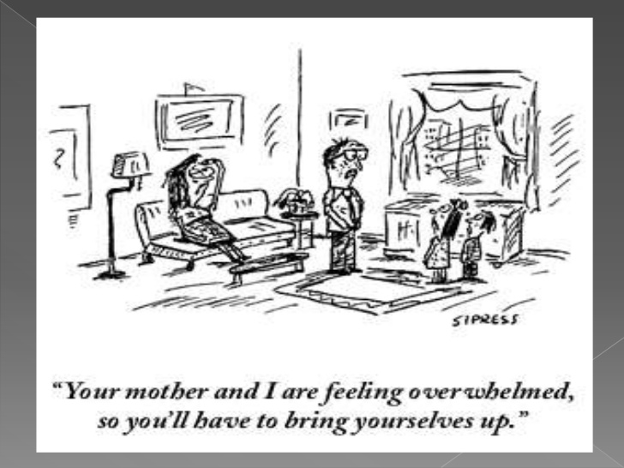
MYTHS OF FAMILY THERAPY
http://www.slideshare.net/anaKniTetangpulah/family-systems-therapy

Slide 25
MYTHS OF FAMILY THERAPY
The Simpsons visit a Family Therapist
A typical family therapy session (Video by a Family Therapist)
What are the misconceptions present in the clip?
How do you think the therapist handled it?
How would you handle a situation like this?
http://www.youtube.com/watch?v=9PU-hTdkzg8
What are the misconceptions present in the clip?
How do you think the therapist handled it?
How would you handle a situation like this?
http://www.youtube.com/watch?v=d7A8hkBovDw

Slide 26
MYTHS OF FAMILY THERAPY
Myth1: Family Therapy is only for married people and families
Works with individuals too because a relational context is formed
Myth2: Therapy goes on forever
Usually solution focused and brief by nature
Myth3: Therapy is only for people with “serious” issues
Work with families who are at routine transitional roadblocks as well
Myth4: Every problem that you bring to therapy must be solved
Most issues that clients come to therapy need to be dealt with tolerance (69%). Success comes with finding solutions to solvable problems.
http://www.youtube.com/watch?v=vudBR-zD5us

Slide 27
STRENGTHS AND LIMITATIONS
Strengths
Limitations
Applicable and generalizable across cultures
Provides a space for family to address conflict in a healthy manner
A holistic approach that doesn’t place the blame on any single individual.
The entire family is empowered through the processes involved.
Confidentiality
Practicality of finding a time when all members of a family can meet – can be time-consuming
Definition of “family” can make it hard to limit who needs to be in therapy
Has the potential to escalate the problems if not conducted properly or if not sufficiently trained.
Therapists need to be aware of own cultural biases

Slide 28
DISCUSSION FORUM QUESTION: 1
You are now a family therapist. Please read the scenario below.
You are given a case where the identified client is a 16 y/o Caucasian boy who lives at home in a middle class family with his father, mother and 14 y/o sister. The boy is in his sophomore year in a new town and new high school. The son's medical and psychological histories have been unremarkable to date. He has lived a normal physically and psychologically healthy life up until recently. The client reluctantly came for treatment with his family at the urging of his school psychologist and his family doctor due to behavioral problems at school and at home. Both the school psychologist and the family doctor indicated to his parents their concern about the potential chemical dependency issues he might be facing. His behavior at home has become emotionally distant to everyone in his family demonstrated by isolating himself in his room whenever he is at home. He is also verbally aggressive with his mother and sister.
a) How would you deal with the family? Pick one of the four theories presented and/or one of the eight lenses to approach the scenario.
b) How does the theory and lens you have chosen conform to your own emerging personal theory?

Slide 29
DISCUSSION FORUM QUESTION: 2
The following is a quote from Virginia Satir
To what extent do you agree or disagree with this statement? Are there any limitations? How could you apply this to your current life/work situation?
“The family is a microcosm. By knowing how to heal the family, I know how to heal the world”

Slide 30
RESOURCES AND REFERENCES
About Virginia Satir. (n.d.). Satir Global About Virginia Satir Comments. Retrieved from http://satirglobal.org/about-virginia-satir/
Bowen Family Systems Theory and Practice: Illustration and Critique. (n.d.). The Family Systems Institute. Retrieved from http://www.familysystemstraining.com/papers/bowen-illustration-and-critique.html
Bowen Theory. (n.d.). The Bowen Center. Retrieved from http://www.thebowencenter.org/pages/theory.html
Counseling Theories. (n.d.). Family Systems Therapy. Retrieved from http://counsellingtheories.blogspot.ca/2011/01/family-systems-therapy.html
Corey, G. (2009). Theory and Practice of Counselling and Psychotherapy (8th ed.). Belmont, CA: Thomson Brooks/ Cole.

Slide 31
RESOURCES AND REFERENCES
Family Systems Theory. (n.d.). RSS. Retrieved from http://www.familysystemstheory.com/ourhistory.html
Ideas To Action. (n.d.). Ideas To Action. Retrieved from http://ideastoaction.wordpress.com/dr-bowen/
Lappin, J. (1988). Family therapy: A structural approach. In R. Dorfman (Ed.), Paradigms of Clinical Social Work. New York: Brunner/Mazel.
Neill, J. R., & Kniskern, D. P. (Eds.). (1989). From psyche to system: The evolving therapy of Carl Whitaker. Guilford Press.
Structural Family Theory. (n.d.). The Minuchin Centre for the Family. Retrieved from http://minuchincenter.org/structural_family_therapy

